Slide 1
Safety Governance for Health & Safety Professionals

Slide 2
Overview
Governance essentials
Health and safety governance
The role of the H&S professional
Relationships
Providing specialist advice
Influencing
Professional development

Slide 3
Focus
Theory
Practice

Slide 4
Governance Essentials

Slide 5
Four Pillars of Effective Governance
Determining purpose
Building an effective Governance culture
Effective compliance
Holding to account

Slide 6
Overview
WHAT, WHERE, WHY?
Governance | Defines leadership role, sets plans, policies and high ethical standards Longer-term focus and a helicopter view Monitors and holds management to account
HOW?
Management | Executes board approved strategy Works to the business plan Has a day-to-day operational focus
Source: Institute of Directors in New Zealand (Inc) – The Four Pillars of Governance Best Practice, 2017.
Notes:
Whiteboard exercise

Slide 7
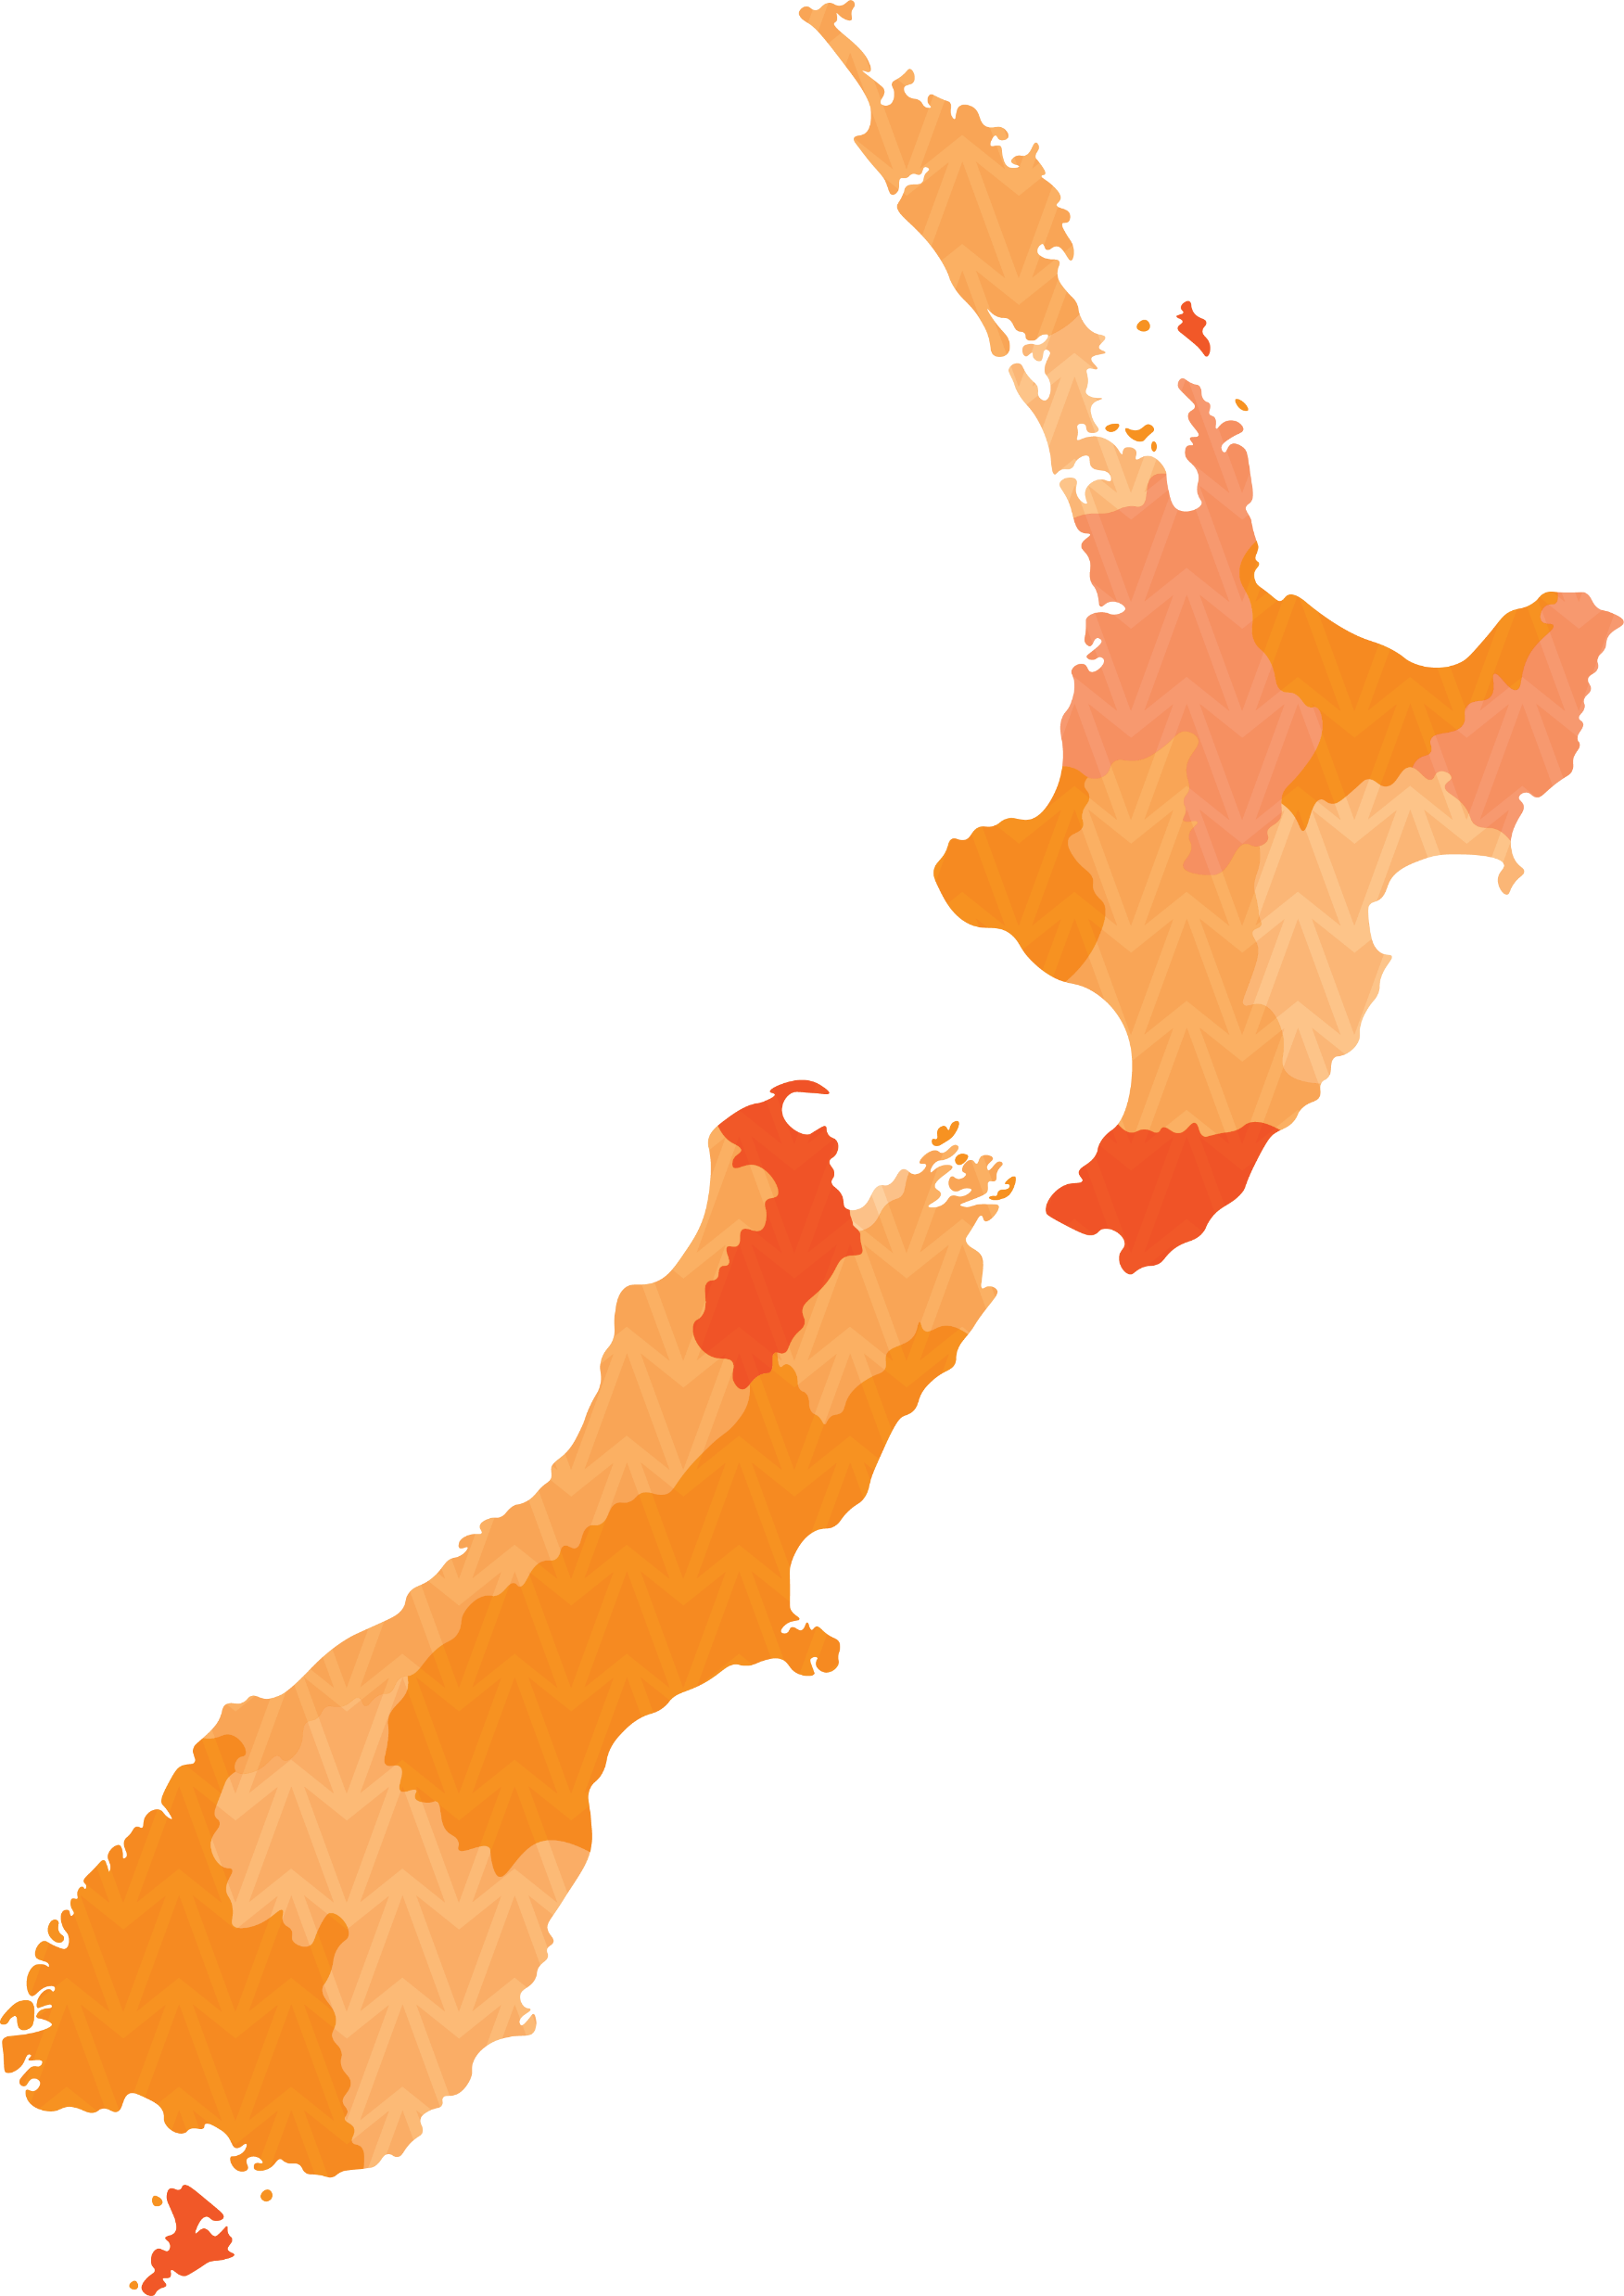
New Zealand Context
NZ still in learning state
Good examples of H&S governance found overseas
Mature H&S Systems and Culture

Slide 8
Health & Safety Governance

Slide 9
What is Health and Safety Governance?
The structure for setting the vision and commitment to health and safety
Agreement on how health and safety objectives will be met
The framework for monitoring performance
A means for ensuring legal obligations are met

Slide 10
Active Enquiry
HSWA requires Officers to take active enquiry to meet their due diligence obligations
Officers hold specific due diligence duties under HSWA

Slide 11
Duties of Officers
Exercise due diligence regarding health and safety
Keep up-to-date in their knowledge
Understand PCBU operations
Ensure PCBU has resources for managing risks
Ensure PCBU has processes for managing risks
Ensure there are compliance processes
Verify resources and processes

Slide 12
Governance Practices
Board Charter, Roles and Responsibilities
Reporting Framework (monitoring performance)
Safety Leadership for Board Members
Board Education

Slide 13
Safety Governance Maturity Pathway
Transactional
Compliant
Focused
Proactive
Integrated
Minimal emphasis on health and safety, transactional approach, reactive following incidents. No disclosures.
Compliance focused rather than on culture. Roles and responsibilities established, health and safety policy established. Brief references to safety disclosures.
Compliance framework , Board Charter and Vision established, targets and objectives and lead indicators in place. Disclosure of H&S systems and processes
Safety leadership and a personal commitment to safety established. Board Sub Committee in place. Board seeks great safety performance from Executive Team. Disclosures include Chair commitment to safety and lead and lag indicators.
Board ensures health and safety is integrated into operations. Link between safety performance and safety excellence is understood and accepted. Clear statements of H&S disclosures are honest and transparent.

Slide 14
Health & Safety Disclosure Considerations
Health and Safety Vision
Personal Commitment
Decision making
Transparency

Slide 15
Safety Leadership Considerations
Personal Commitment
Decision making
Transparency

Slide 16
Effective H&S Governance Ensures
Directors, CEs and senior leaders have the framework, systems, processes, tools and knowledge in place to improve the H&S performance of the organisations they govern and lead
Sets important standards for organisational culture
Safety leadership practices positively influence organisational culture
Benefits
Notes:
Whiteboard exercise

Slide 17
Role of the Health & Safety Professional

Slide 18
Relationships
Understand relationship between CE, ELT and Board (tension)
Build positive relationships with senior leaders, CE and Directors

Slide 19
Providing H&S Advice
Challenge to ensure focus is on the right issues
Credible H&S advice

Slide 20
Influencing
Leadership skills
Coaching and mentoring skills

Slide 21
Discussion
Governance essentials
Health and safety governance
The role of the H&S professional
Relationships
Providing specialist advice
Influencing
Professional development
What are some of the challenges you are having in influencing your Senior Leaders and Board of Directors?
Notes:
Whiteboard exercise

Slide 22
Professional Development

Slide 23
Professional Development
Institute of Directors
Victoria University Professional and Executive Leadership Education and courses
Massey University Executive Education short courses

Slide 24
Summary
H&S professionals can influence better health and safety outcomes through developing positive relationships with Officers and providing robust H&S advice

Slide 25
Questions
Notes:
Whiteboard exercise

